Slide 1

Dunfermline Foodbank
AGM
25th February 2025

Slide 2
Agenda
Chairperson report
Financial report
Foodbank Manager report and look ahead
Election/re-election of Charity Trustees

Slide 3
Chairperson Report – Martin Smith
Activity
Operation of the Foodbank has continued effectively
Stable financial position
Attended cluster meetings with other foodbank trustees and attended Trustee training events

Slide 4
Chairperson Report
Look forward
Implementation of contingency planning
Review ongoing strategy and procedures
Continue to seek new funding opportunities for long term financial stability
Trussell governance health check

Slide 5
Chairperson Report
Trustees
There have been no Trustee changes in the past year.
Current Trustees are :
  Martin Smith (Chairperson)
  Jon Farrimond (Treasurer)
  Janet Brand (Secretary)
  Mitch Skinner
  David Henderson
  Peter Lloyd

Slide 6
Financial Report - Year to Jun 2024

Slide 7
Financial Report - Year to Jun 2024

Slide 8
Financial Report - Year to Jun 2024

Slide 9
Foodbank Manager's Review
2025

Slide 10
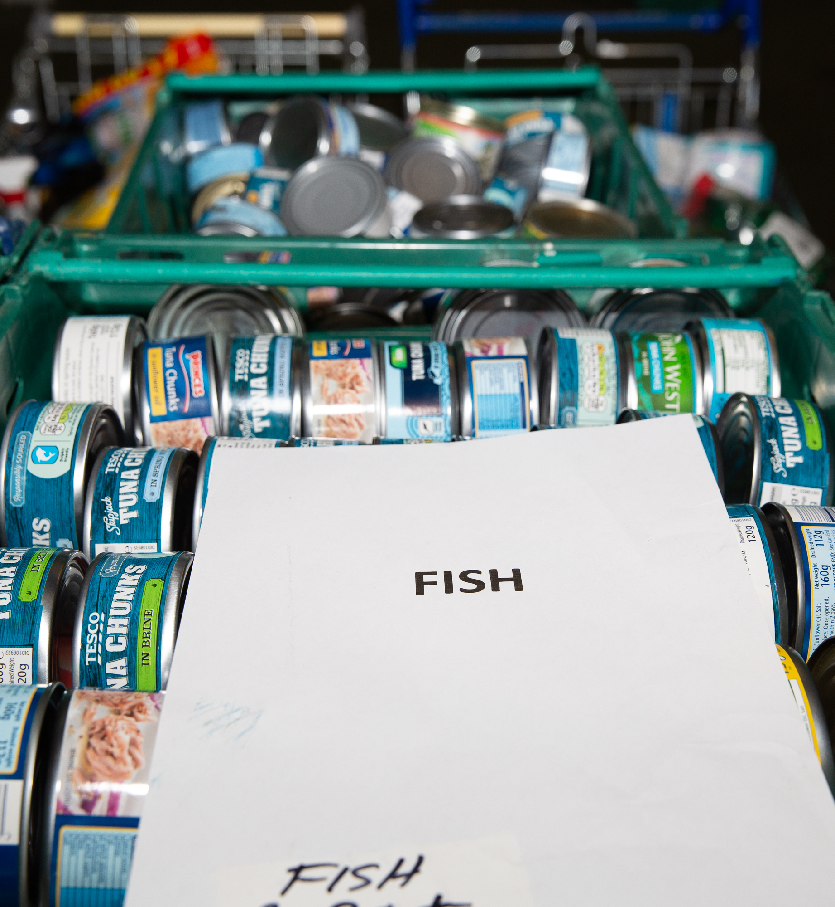
Foodbank figures
1st April 2023 to 31st March 2024
We fed 8,814 people of which there were 5,467 Adults and 3,347 Children – Client use down by 4% on 2022/2023
98,055kgs of Food donated – down by 10%
94,665kgs of Food distributed to people in need – down by 20%

Slide 11
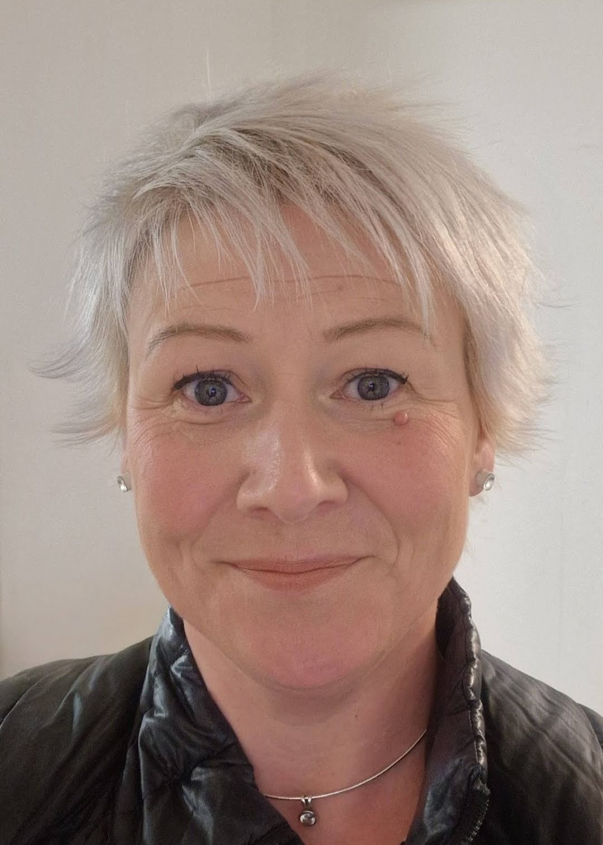
New Assistant Foodbank Manager
In September 2024 we welcomed Vicky Gorn as our new Assistant Foodbank Manager. Since then, Vicky has become a valuable member of the team and has already led on a few initiatives including; our reverse Christmas Advent calendar and a successful recruitment drive.
Vicky covers foodbank operations on a Tuesday, Wednesday and Thursday which frees up the Foodbank Manager to work on strategic planning for Dunfermline Foodbank.

Slide 12
New Trussell Branding
In September 2024, Trussell Trust rebranded and are now known as 'Trussell'.
A new logo was introduced along with a new Vision and Mission Statement: -
Our vision is for a UK without the need for food banks. Our strategy sets out how we’re going to get there. We want to ensure everyone can afford the essentials in life. We’re working towards a compassionate, just society without the need for large-scale emergency food distribution.
We are slowing but steadily changing our branding to match Trussell and will continue to change the branding on our vans and signage this year.

Slide 13

Update: - E Referring
Almost all Referrers are using the E Referral system, around 99%. John Thompson has been the lead on this initiative and has worked hard to make sure Referrers are signed up quickly and know how to use the system.
Our Foodbanks will still accept Red Vouchers but they will and are being phased out.

Slide 14


Forward Planning 2025...
The new role of Income Maximisation Officer will be filled in March 2025 .
Develop our Strategy Plan.
Be more proactive in the Cash First Approach Pilots running in the Dunfermline and South West Fife Poverty Action Group areas.
The need to raise the profile of the Foodbank will still be the number one priority, as we have to ensure a steady donation stream.
We have a strong, dependable reputation in the local area and we will strive to keep that by maintaining and improving our service.

Slide 15


Slide 16
Election/re-election of Charity Trustees
Proposed Trustee office bearers :
  Peter Lloyd (Chairperson)
  Martin Smith (Treasurer)
  Janet Brand (Secretary)

