Slide 1
Dunfermline Foodbank
AGM
28th February 2023

Slide 2
Agenda
Chairman report
Financial report
Foodbank Manager report and look ahead
Election/re-election of Charity Trustees

Slide 3
Chairman Report – Martin Smith
Activity
Operation of the Foodbank has continued effectively
Stable financial position
Attended cluster meetings with other foodbanks
Undertaken a Governance Health check

Slide 4
Chairman Report
Objectives
Act on output from Governance Health check
Warehouse Lease renewal
Continue to seek funding options

Slide 5
Trustees
There have been two Trustee changes in the past year
  Diane Garriock (Deceased 10th October 2022)
  Peter Lloyd (Appointed April 2022)
And the current Trustees are :
  Martin Smith (Chairperson)
  Jon Farrimond (Treasurer)
  Janet Brand (Secretary)
  Mitch Skinner
  David Henderson
  Peter Lloyd

Slide 6
Financial Report - Year to Jun 2022

Slide 7
Financial Report - Year to Jun 2022

Slide 8
Financial Report - Year to Jun 2022

Slide 9

Project Manager Review
February 2023

Slide 10
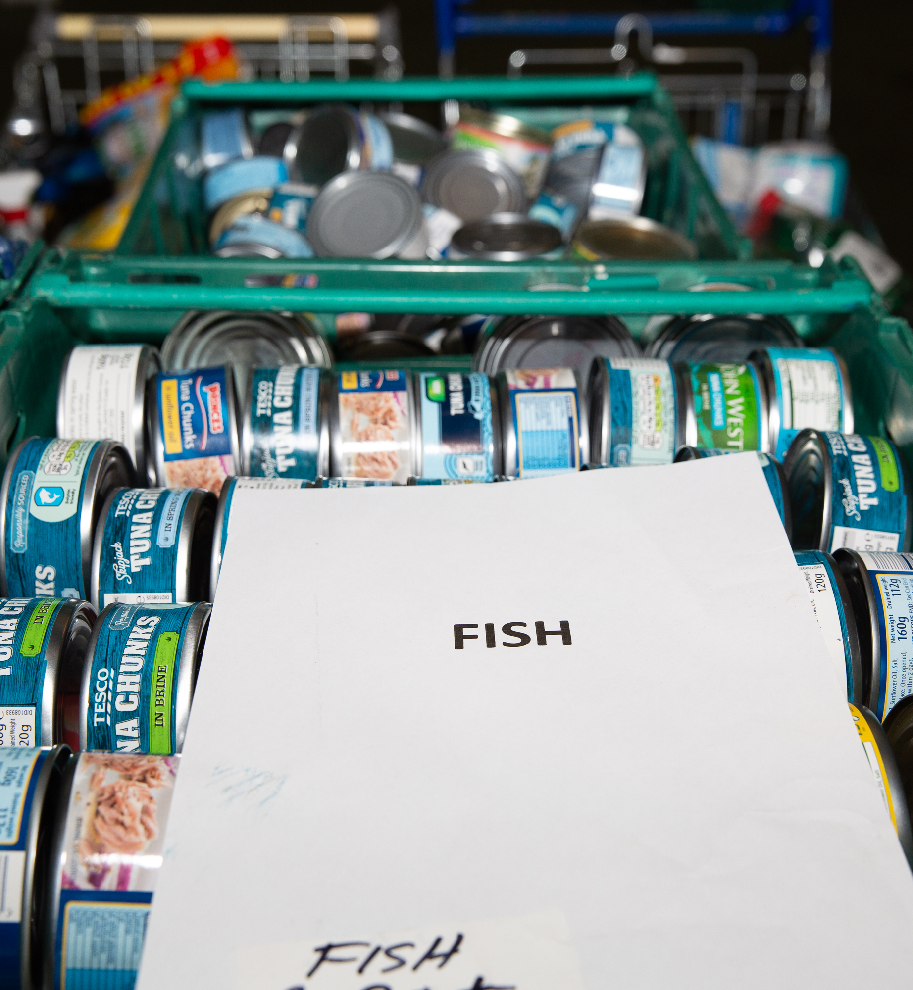
Foodbank figures
2021/2022
We fed 7,184 people of which there were 4,324 Adults and 2,860 Children – Client use down by 9% on 2020/2021
86,359kgs of Food donations in – up by approximately 1%
104,725kgs of Food distributed to people in need – up by 9%

Slide 11
The last year
(April 2022 – Present)
It has been an extremely busy year (April 2022 – Present) and with client numbers steadily rising and donations dropping it was a tense time for a short while, however, the winter months have seen a rise in donations and lots of help via funding etc to buy in extra stock, and as a result we have managed to keep our head above water.
Recruitment of new volunteers has helped keep the foodbanks and warehouse well manned and we had a great response from Dunfermline Rotary Club with additional drivers which we desperately needed.
No moves this year which has been great and with Covid restrictions easing steadily we are almost back to 'normal' routine.

Slide 12


Forward Planning 2023...
There is constant and never ending improvements going on behind the scenes. Our service is needed now more than ever and have had to move with the times making change inevitable.
We strive to keep all volunteers up to date with changes as they happen.
The need to raise the profile of the Foodbank is my number one priority at the moment, as we have to ensure a steady donation stream.
We have a strong, dependable reputation in the local area and we will strive to keep that by maintaining and improving our service.

Slide 13

Update: -
E Referring
September 2021 - Present
All 5 Foodbanks started using the E-Referral system in September 2021.
The number of Referrers using this system has risen substantially and we will continue to push for this method to be used.
This is a live system where Team Leaders fulfill electronic referrals and input stock issued so it doesn't have to be done manually after the event.
We now also have a system where stock orders from the Foodbanks are sent directly to the Warehouse electronically.

Slide 14

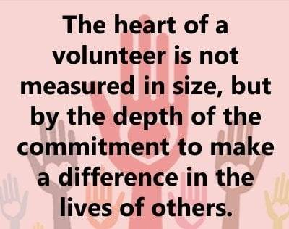

Slide 15
Election/re-election of Charity Trustees

